Slide 1
PHD Progression 8
Explainable AI with Visual analytics

Slide 2
Building LLMs From scratch
BUILD A LARGE LANGUAGE MODEL(FROM Scratch) - sebastian raschka
Vizuara(Youtube)

Slide 3
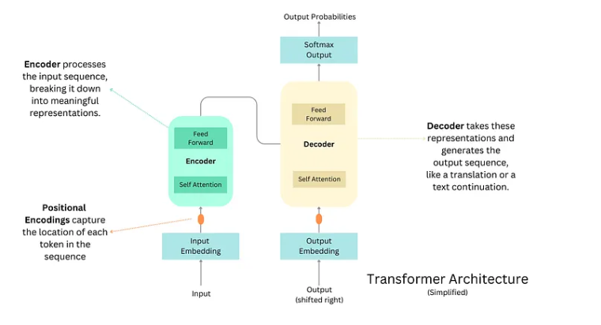
Building LLMs From scratch
Attention is all you need by google brains
Image of a simplified transformer
creating an LLM = pretraining + Finetuning

Slide 4
Building LLMs From scratch
BERT: Bidirectional encoder representations from transformers. Encoder only architecture, It works by predicting hidden words. Due to bidirectionality it’s suitable for sentiment analysis
GPT: Generative pretrained Transformers. Decoder only architecture, it works by predicting the next word
GPT-3 175 Billion parameters
GPT,GPT-2, GPT-3, GPT-4 all these models are pretrained versions built for predicting the next word, due to large corpus develop emergent behavior.

Slide 5
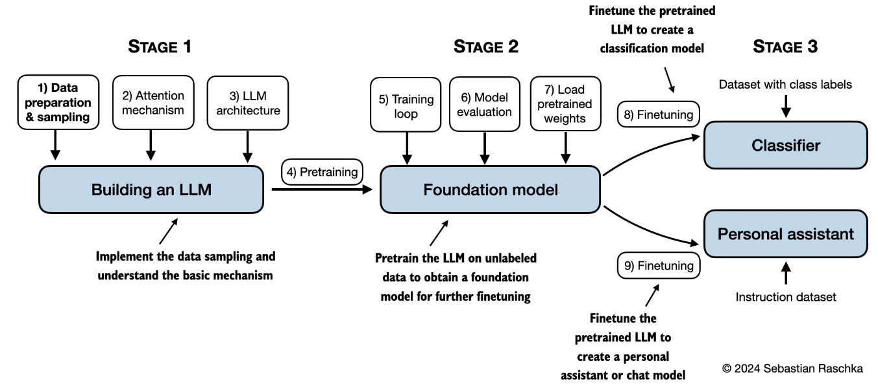
Building LLMs From scratch

Slide 6
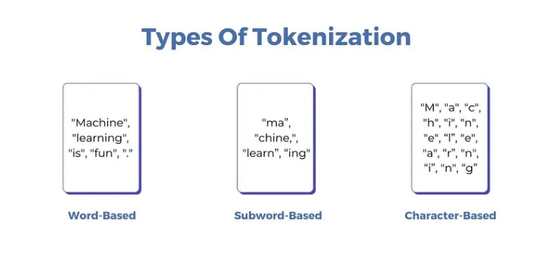
Building LLMs From scratch: Data preprocessing and sampling
Tokenization of words
Token: A unit of a text which the model reads
Word based token: very large vocabulary required, out of vocabulary words problem
Character based token: few vocabulary, Words lose their meaning, token sequence is longer than raw text
Sub-word-based token: few vocabulary, solves both issues

Slide 7
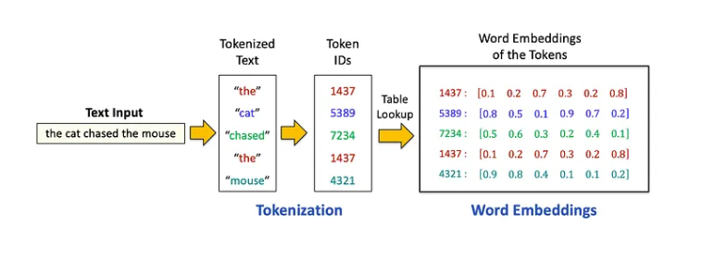
Building LLMs From scratch: Data preprocessing and sampling
Vocabulary: list of unique tokens sorted in alphabetical order
Sub-word-based tokenization is used for GPT e.g byte pair encoding
BPE algorithm: most common pair of consecutive bytes of data is replaced with a byte that does not occur in the data

Slide 8
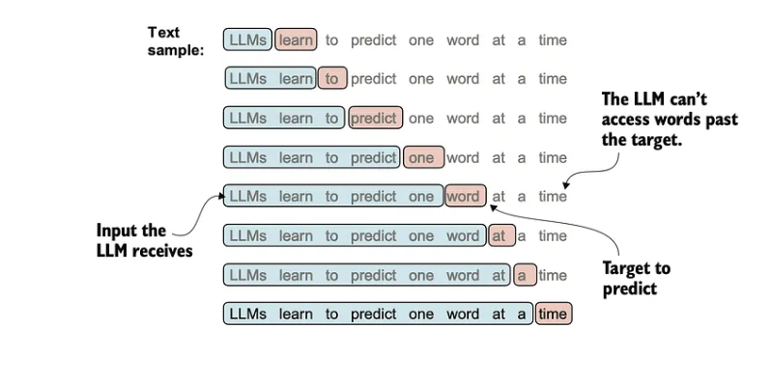
Building LLMs From scratch: Data preprocessing and sampling
Creating Input-Target pairs
Self supervised learning or Autoregressive
X:[1,2,3,4]
Y:[2,3,4,5]
Y=X+1
Create a data loader to do this Y=X+1

Slide 9
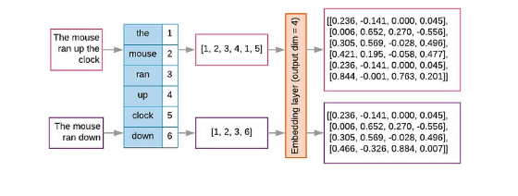
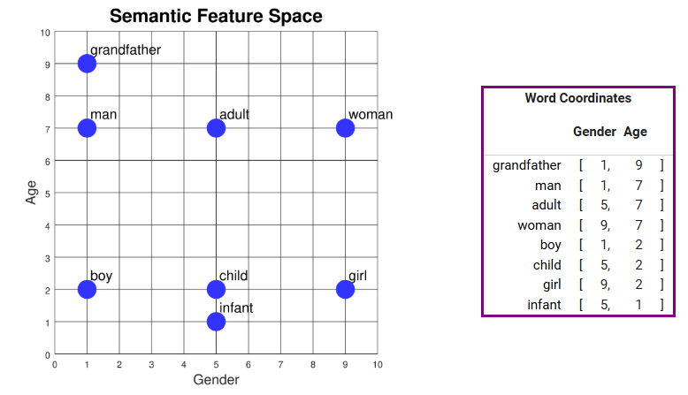
Building LLMs From scratch: Data preprocessing and sampling
To retain semantic meanings between tokens we need vector embedding
We then create a Token embedding
Word2vec example
Embedding weights are initialize randomly and later optimized during training

Slide 10
Building LLMs From scratch: Data preprocessing and sampling
Positional embedding
The same tokenID gets mapped to the same vector representation, regardless of its position in the input sequence
The cat sat on the mat
On the mat the cat sat
Additional information on its position is needed

Slide 11
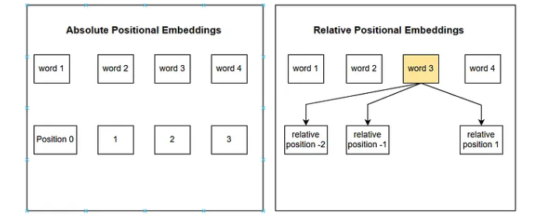
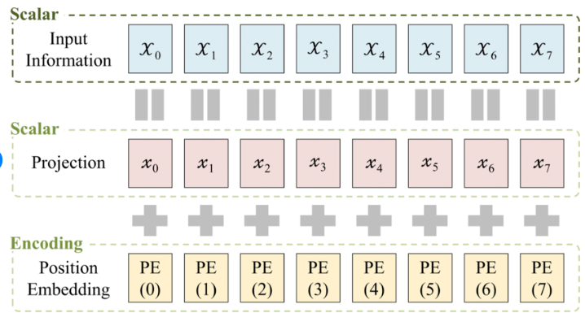
Building LLMs From scratch: Data preprocessing and sampling
There are two types of positional embeddings
Absolute: Unique embedding is added to the token’s embedding to convey it’s position
Relative: emphasis is placed on the relative position or distance between tokens
Input embedding = token embedding + position embedding

Slide 12
Building LLMs From scratch: Data preprocessing and sampling
positional embedding is suitable when fixed order of tokens is crucial, such as sequence generation( GPT, and initial transformer)
Relative positional embedding is suitable for tasks like language modelling over long sequences, where the same phrase can appear indifferent part of the sequence.
https://github.com/Lanre9799/LLMfromscratch.git

Slide 13
Supervisors feedback
Feedback

